Slide 1


Slide 2

Referential integrity is a database concept that ensures that relationships between tables remain consistent.
When one table has a foreign key to another table, the concept of referential integrity states that you may not add a record to the table that contains the foreign key unless there is a corresponding record in the primary table.
It also includes the techniques known as cascading update and cascading delete, which ensure that changes made to the primary table are reflected in the linked table.
BUT TAKE CARE IF YOU SPECIFY THESE!

Slide 3

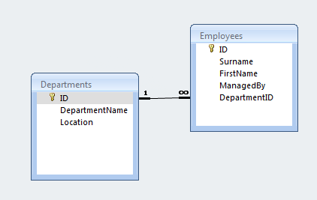
Two tables: Employees and Departments
The Employees table has a foreign key attribute entitled DepartmentID which points to the record for that employee’s department in the Departments table.

Slide 4

We may not add a record to the Employees table unless the DepartmentID attribute points to a valid record in the Departments table.
If the primary key for a record in the Departments table changes, all corresponding records in the Employees table must be modified using a cascading update.
If a record in the Departments table is deleted, all corresponding records in the Employees table must be deleted using a cascading delete.

Slide 5

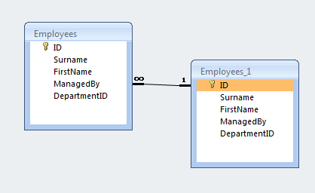
One table: Employees (self-referencing)
The Employees table has a foreign key attribute entitled ManagedBy which points to another record in the same Employees table to show that employee’s manager
Employees_1 the same table as Employees – it is called an alias.

Slide 6
We may not add a record to the Employees table unless the ManagedBy attribute points to a valid record in the Employees alias table.
If the primary key for a record in the Employees alias table changes, all corresponding records in the Employees table must be modified using a cascading update.
If a record in the Employees alias table is deleted, all corresponding records in the Employees table must be deleted using a cascading delete.

Slide 7

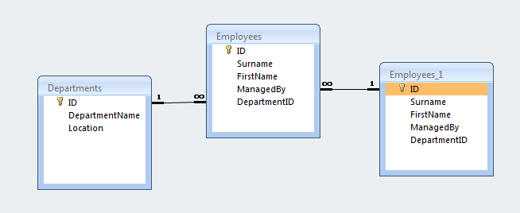

Slide 8

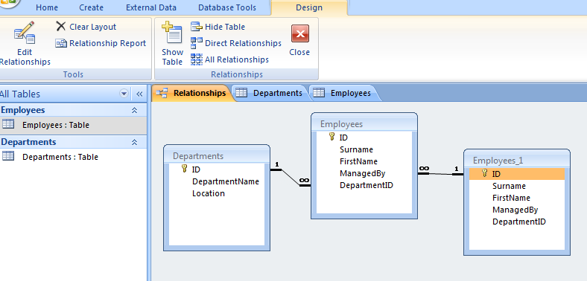
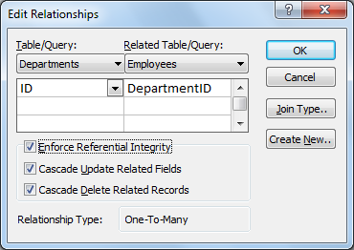

Slide 9

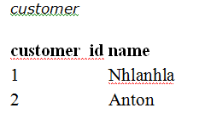
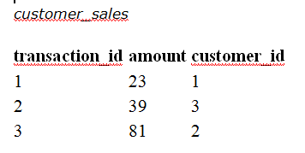
PK
FK
Orphan record:
Who is customer 3?

Slide 10
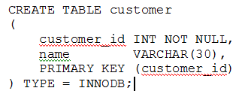
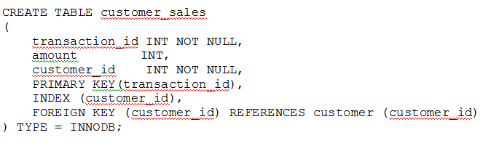
Both tables need to be InnoDB tables.
Use the syntax FOREIGN KEY(fk_fieldname) REFERENCES table_name (fieldname)
The field being declared a foreign key must be an index in the table definition

Slide 11

When creating a new record
When deleting a record
When updating a record.
The FOREIGN KEY (transaction_id) REFERENCES customer (customer_id) clause ensures that when a new record is created in the customer_sales table, it must have a corresponding record in the customer table.

Slide 12


You cannot add the record, as customer_id 3 does not exist.

Slide 13


Slide 14


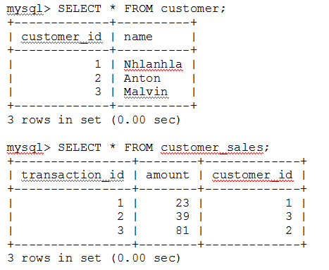
PK
FK

Slide 15


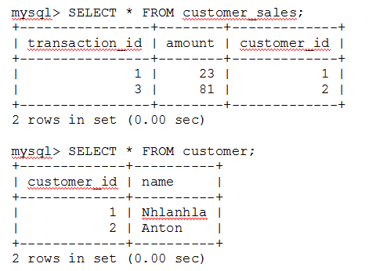
customer_sales record
has also been removed.
Take care!

